Slide 1
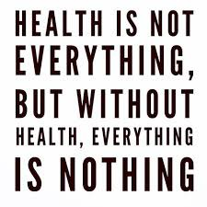

HEALTH IS EVERYTHING

Slide 2
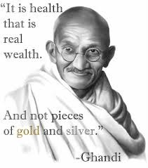
Health is a state of complete harmony if the body mind and spirit. To ensure good health eat lightly breathe deeply live moderately.

Slide 3


BE ACTIVE TO BE HEALTHY

Slide 4
PHYSICAL ACTIVITY OR EXERCISE CAN IMPROVE YOUR HEALTH AND REDUCE THE RISK OF DEVELOPING SEVERAL DISEASES

Slide 5


BALANCED DIET

Slide 6
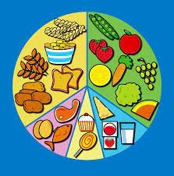
A balanced diet is a diet that helps to maintain or improve overall health
It also contains calories ,proteins ,minerals, vitamins and alternative nutrients is adequate.

Slide 7


DO NOT EAT JUNK FOOD

Slide 8

EAT HEALTHY FOOD
The Researchers concluded that replacing saturated fat in your with polyunsaturated fats can reduce your heart disease risk
To reduce saturated fat we should – 1. Eat more fruits and vegetables. 2. Eat more fish and chicken. 3. Bake , boil or grilled meat , avoid fried meat

Slide 9


DRINKING WATER MAKES YOU HEALTHY

Slide 10
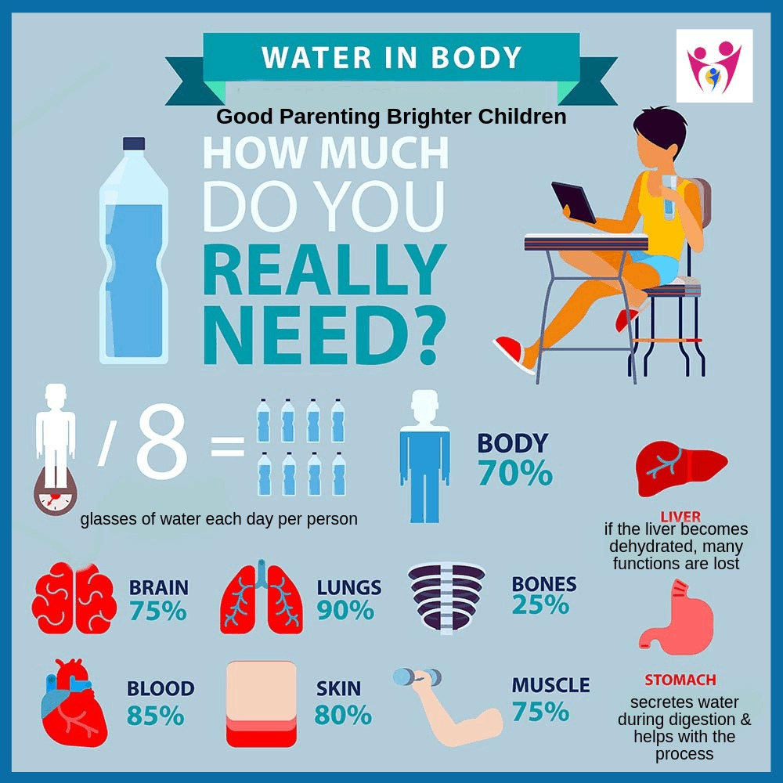
Water carries nutrients and oxygen to your cells and protects organs and tissues.
The amount of drinking water required to maintain good health varies, and depends on physical activity level, age, health-related issues and environmental conditions.

Slide 11


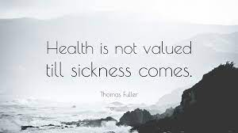

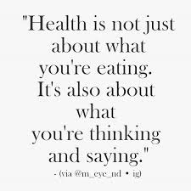
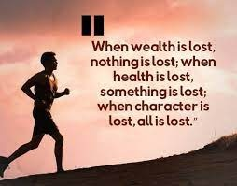

Slide 12
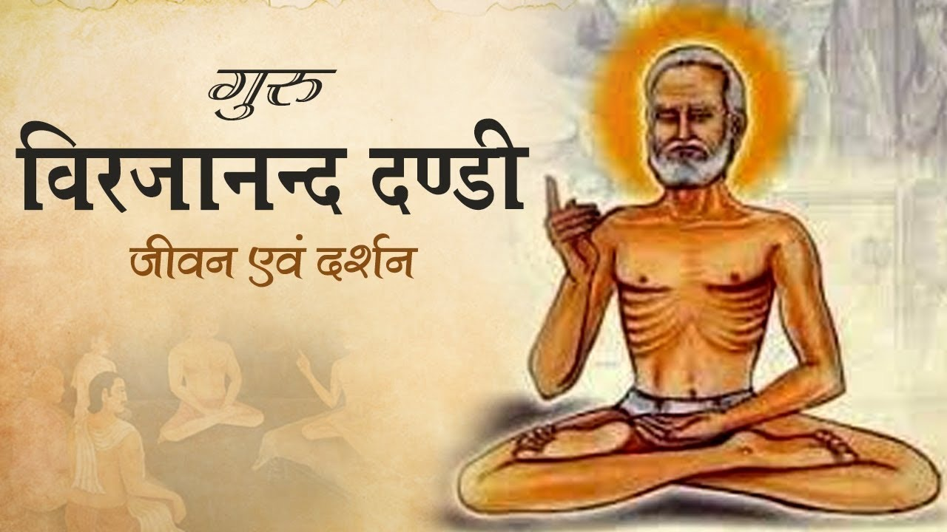

Slide 13

BY-
7B RISHI KIRSHNA
7B MITHRAN BABU
7B SRIKARA CHARAN
7E PIYUSH NAIR

